Slide 1
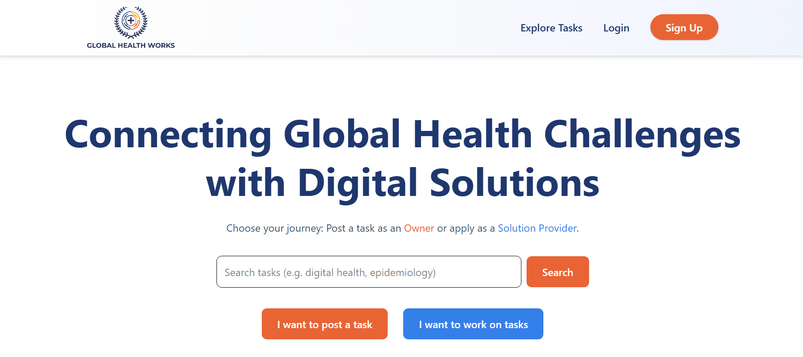
Remove
Replace with
‘The Digital Marketplace for Global Health Solutions’
Replace with
‘Post a task. Solve a task. Together, let’s make global health work.
Remove

Slide 2
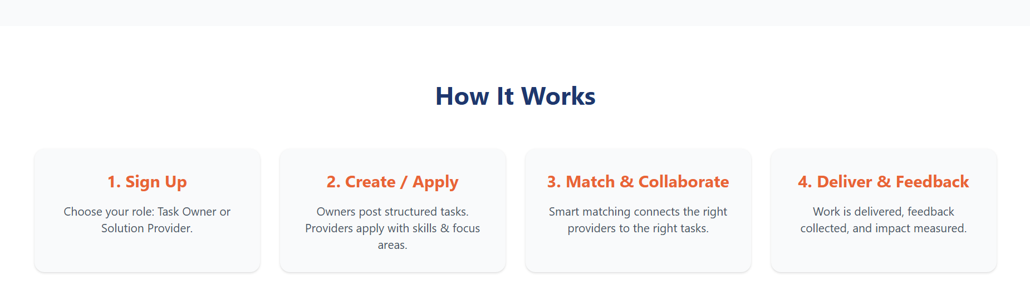
Join the Community
Smart matching connects the right people to the right tasks.
Choose your role: Post tasks as an Owner or solve tasks as a Provider.
Owners create tasks. Providers apply to work on tasks

Slide 3
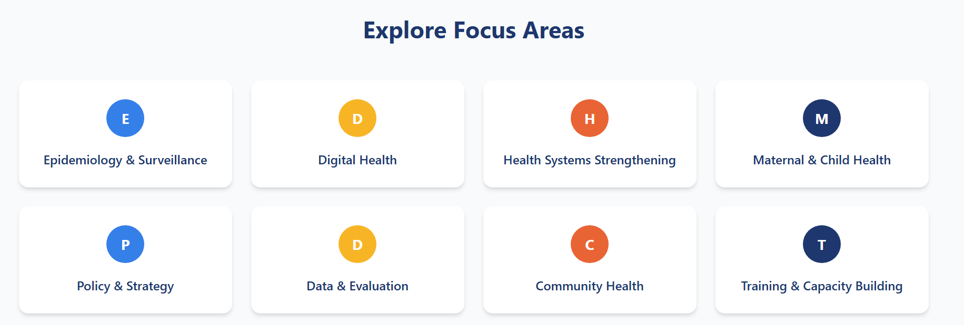
Remove

Slide 4
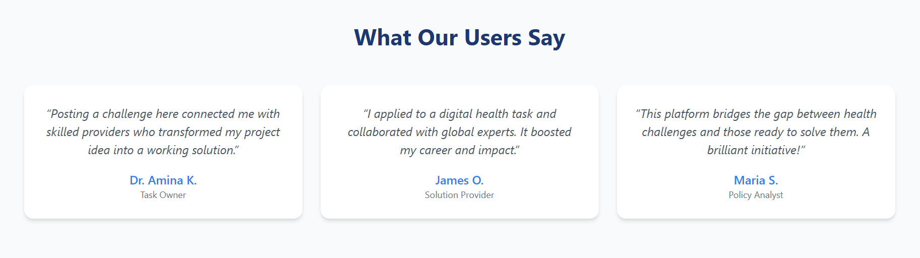

Slide 5
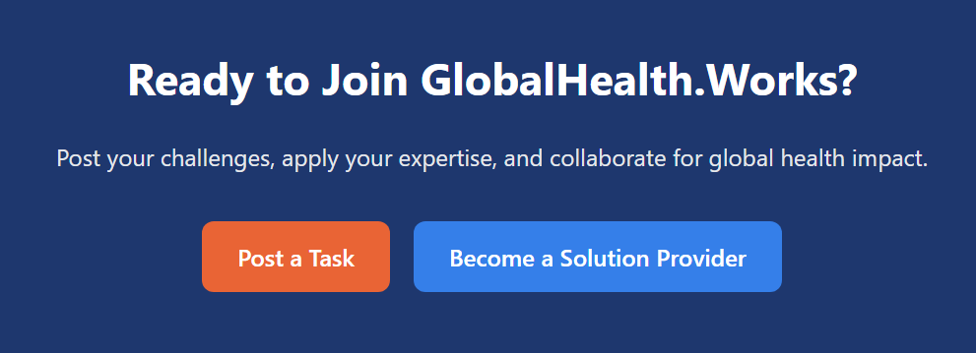
Replace with
‘Post a task. Solve a task. Together, let’s make global health work.

Slide 6

Replace with
‘The Digital Marketplace for Global Health Solutions’
Remove

Slide 7
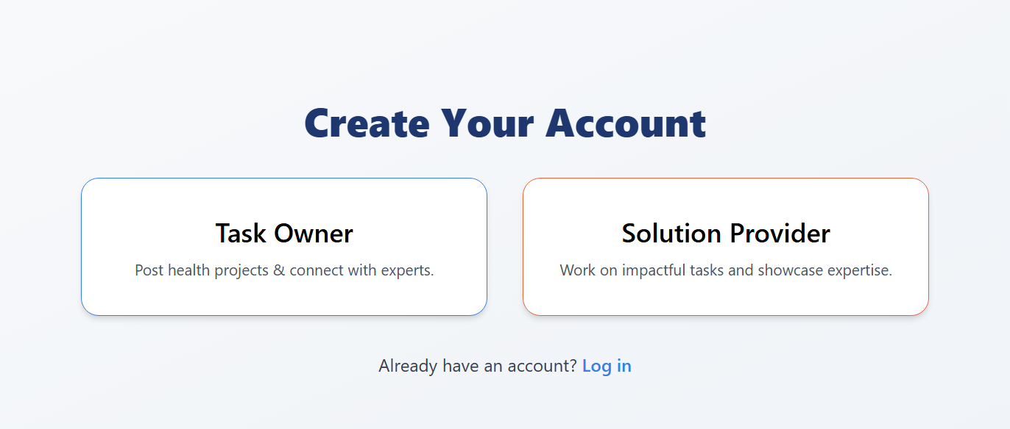
Join the Community
Replace with
‘Work on tasks and showcase your skills’

Slide 8
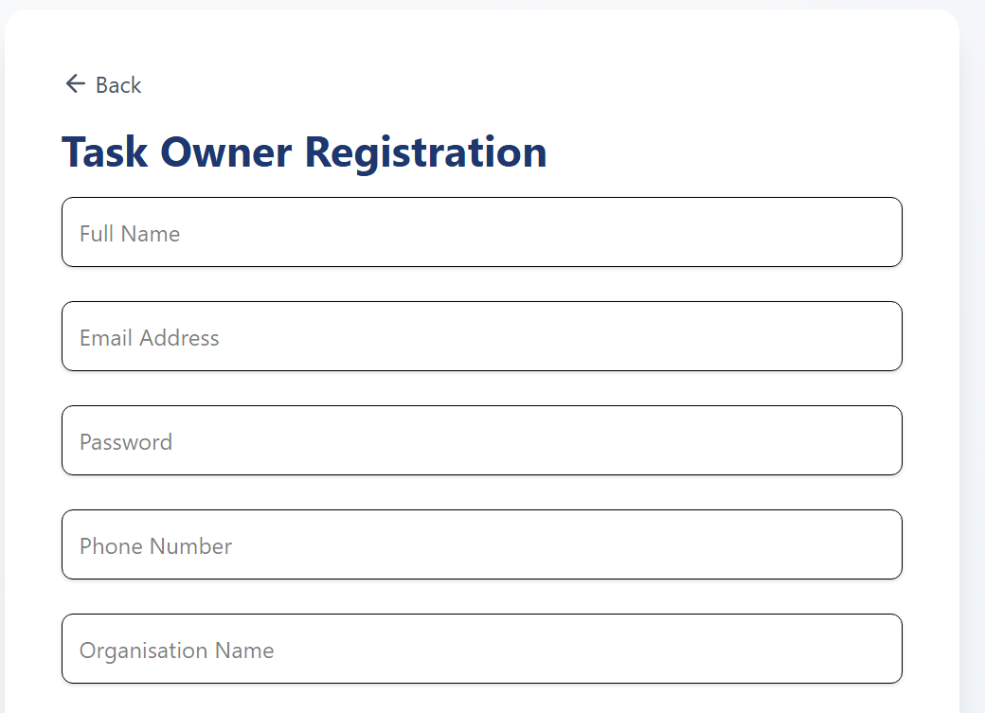
Do we need to have an Asterix so it’s clear which fields are mandatory and which ones are optional
I need two fields for the name, a first name and a surname field, I don’t want a ‘full name’ box to collect them both. I need to be able to address people by their first name or last name, depending on the circumstance
I will also need a title field, it can be dropdown, and optional, with the following options; (1) Dr. (2) Prof. (3) Dr. Prof. (4) Mr. (5) Ms. (6) Mrs. (7) Mx. (8) Rev.
I will need in brackets next to ‘Organisation Name’, or the tooltip (text box that appears when you hover over the element) – ‘Task Owners must work in an organization working in global health. Individual personal projects are not permitted’

Slide 9
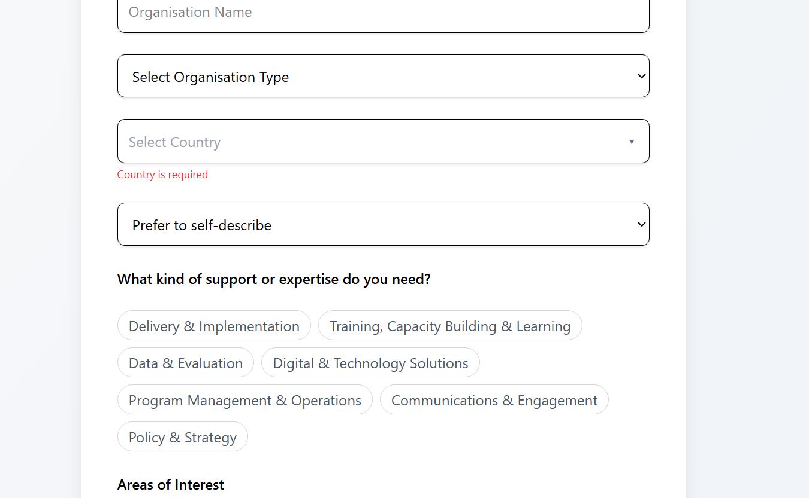
Can the user be allowed to type in their own text when they select ‘prefer to self-describe?’
Strategy & Planning
Research & Analysis
Design & Creative
Technology & Digital Solutions
Communications & Marketing
Training & Capacity Building
Data & Monitoring
Operations & Management
Please update the categories

Slide 10
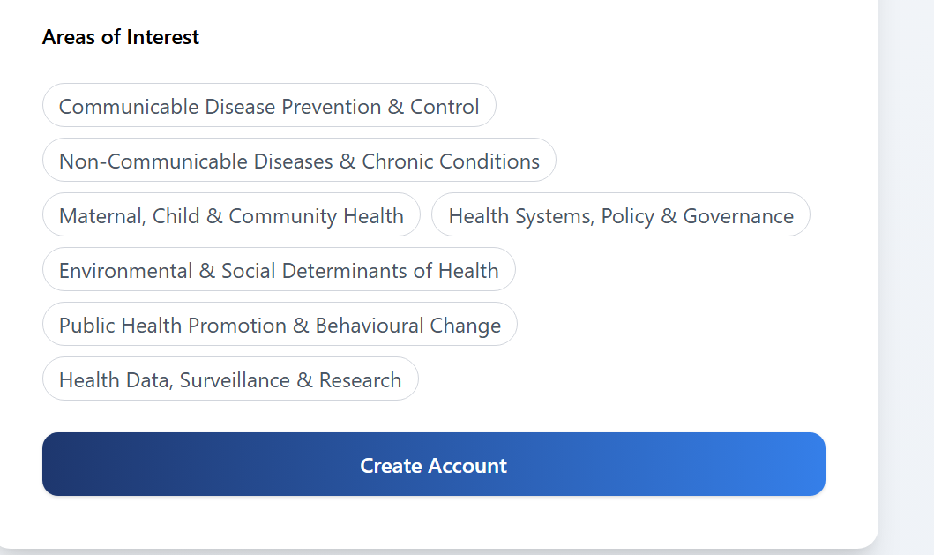
Change to…. Tell us about your areas of interest
Maternal & Child Health Infectious Diseases
Non-Communicable Diseases
Mental Health
Health Systems & Policy
Environmental Health
Community Health
Global Health Security
Other
Please update the categories

Slide 11
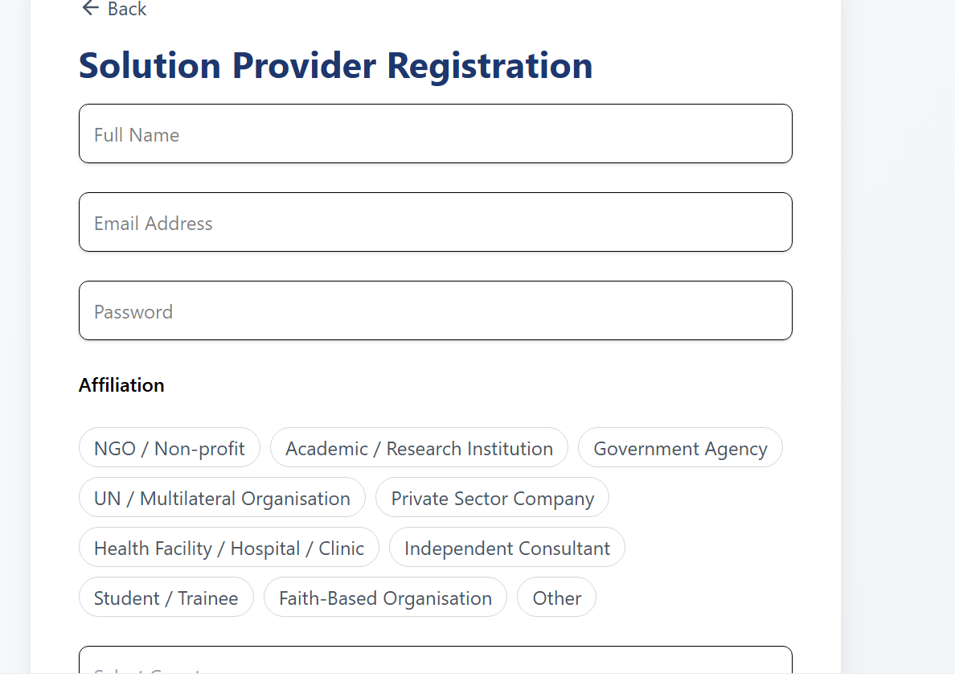
I need two fields for the name, a first name and a surname field, I don’t want a ‘full name’ box to collect them both. I need to be able to address people by their first name or last name, depending on the circumstance
Please change this to a drop down where they can only select one option

Slide 12
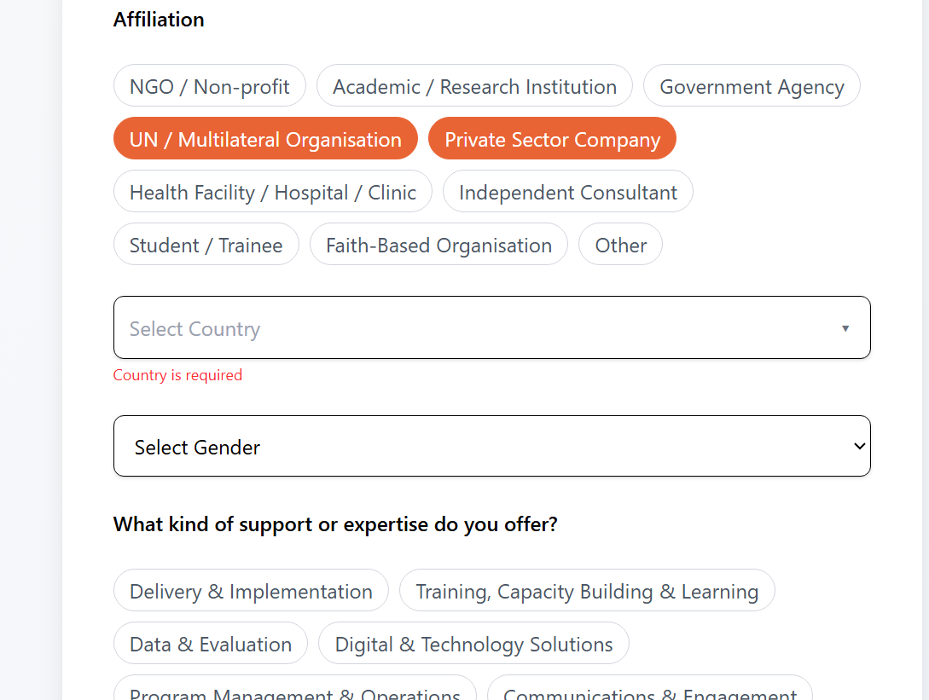
Can the user be allowed to type in their own text when they select ‘prefer to self-describe?’

Slide 13
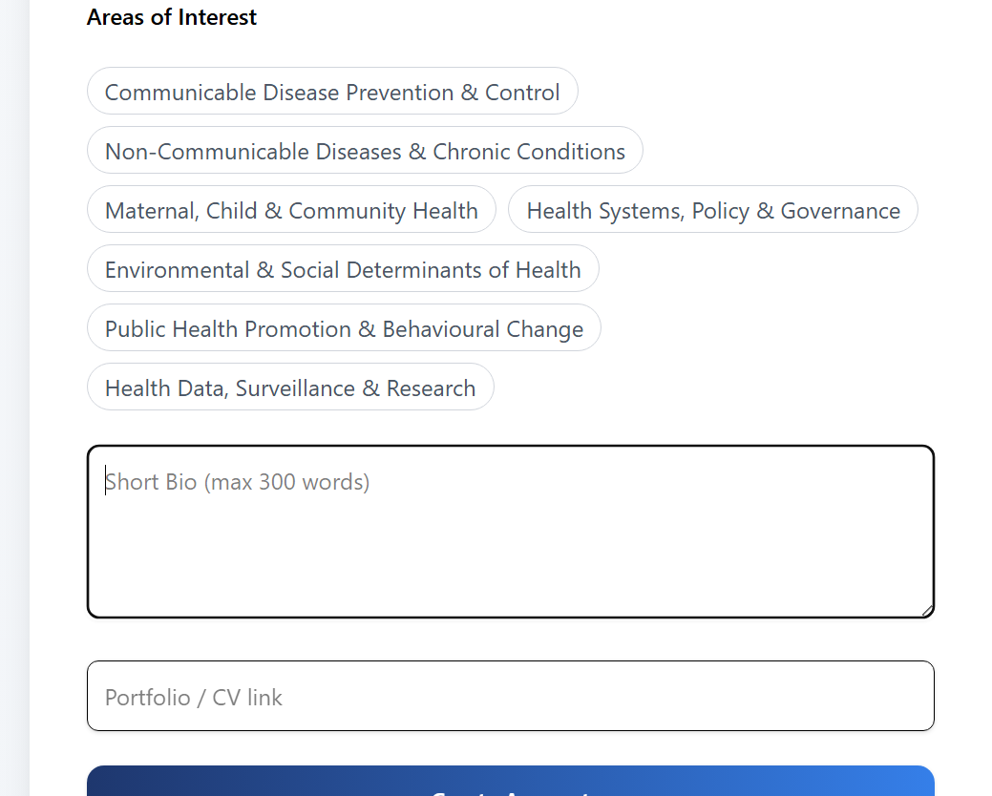
Change to…. Tell us about your areas of interest
Please use updated categories
Maternal & Child Health Infectious Diseases
Non-Communicable Diseases
Mental Health
Health Systems & Policy
Environmental Health
Community Health
Global Health Security
Other
Change to…. LinkedIn / Portfolio / CV link

Slide 14
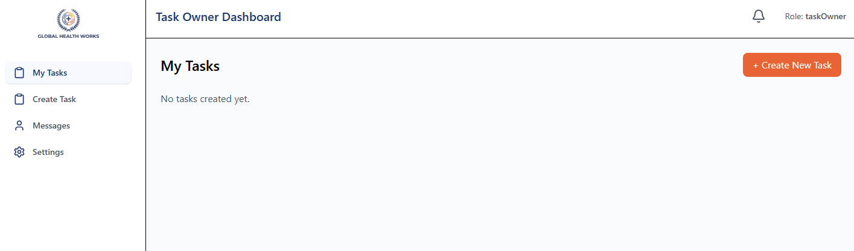
Change to… ‘Task Owner’

Slide 15
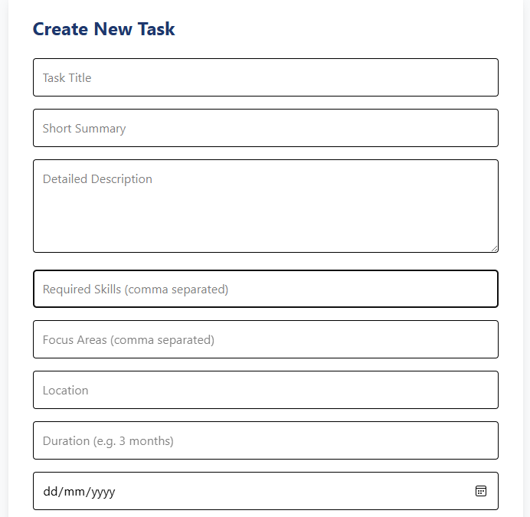
These should be the drop down boxes of ‘support and expertise’ and ‘areas of interest’.
Remove location
Change to ‘How long should this take’
Clarify/Change to ‘Start Date’

Slide 16
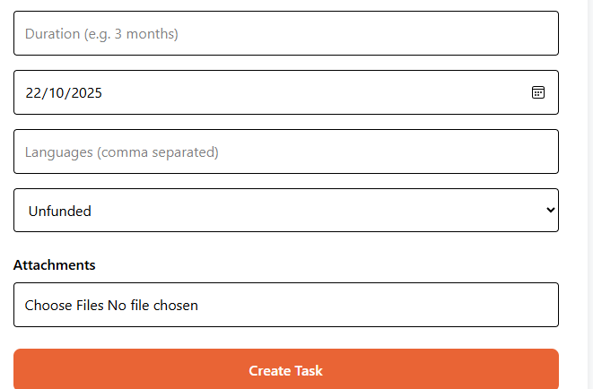
Remove languages and funded boxes
It’s not clear which fields are mandatory and which ones aren’t, and I think this is effecting the ability to create a task.
Can an error message come up if a required field hasn’t been filled in

Slide 17
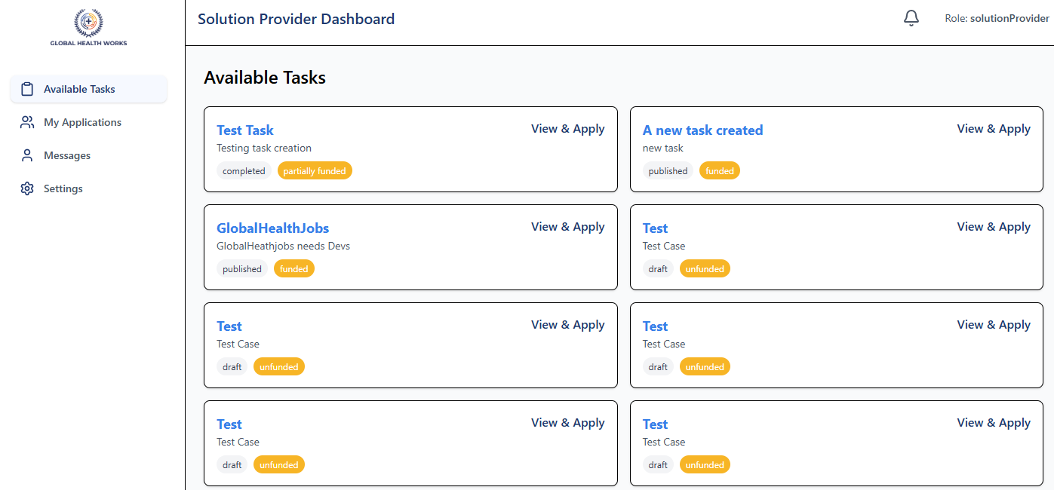
Change to… ‘’Solution Provider’

